Slide 1

Team Mobile
TANNAE
UI Prototype
Algorithm-based Public Transportation Service Mobile Application

Slide 2
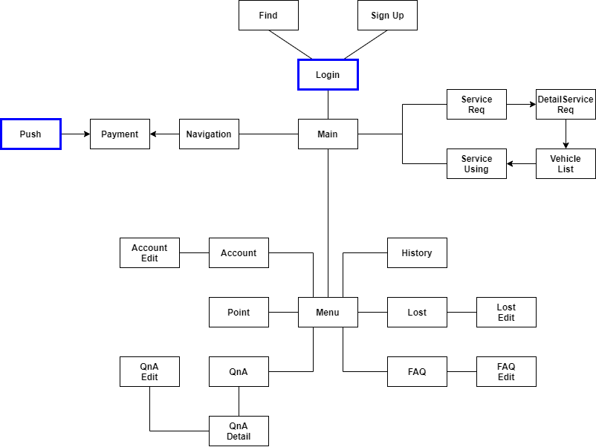
01
Activity Flow Diagram

Slide 3
01
Original

Slide 4
02
Open Screen

Slide 5

02
Login
ID
Password
Find Account | Sign In

Slide 6
02
Sign Up
Back
TANNAE
Account
ID
중복 검사
잘못된 ID 형식입니다.
Password
Password Check
비밀번호 길이가 너무 짧습니다.
Personal
Name
Birth
Sex
Email
Phone Number
Sign Up

Slide 7
02
Find
Back
TANNAE
Personal
Name
Birth
Sex
Email
Phone Number
Find Accout
PIN number
Certificatec
ThisIsMyID
ThisIsMyPW

Slide 8
03
Main
Sing Out
TANNAE
Drive
T

Slide 9
03
ServiceReq
Back
출발지
목적지
Next

Slide 10
03
DetailServiceReq
Back
PredictPrice…
DetailRequirements
Next

Slide 11
03
VehicleList
Back
Predict time location
Predict time location
Predict time location
Predict time location
Predict time location
Predict time location
Next

Slide 12
03
ServiceUsing
Back
Predict price... Lorigin location … desti location…

Slide 13
Driver

Slide 14
03
ServiceReqPopUp
Sing Out
TANNAE
Service Require
출발지 : X
도착지 : Y
YES
NO
T

Slide 15
03
Navigation
Back
END

Slide 16
03
Payment
Back
Receipt
-
-
-
-
Send

Slide 17
03
Menu
Back
TANNAE
QnA
Account
FAQ
History
Lost
&
Found
Payment

Slide 18
03
Account
Back
TANNAE
Account
Labels
ID
Password
Name
Birth
Sex
Email
Phone Number
Edit
Sign Out

Slide 19
03
Account Edit
Back
TANNAE
Account
ID
중복 검사
잘못된 ID 형식입니다.
Password
Password Check
비밀번호 길이가 너무 짧습니다.
Email
Phone Number
Edit
Sign Up

Slide 20
03
Point
Back
TANNAE
Point
15,000 p
Charge
Charge point
Charge

Slide 21
03
History
Back
TANNAE
2022.05.03
Origin
Destination
Vehicle number
Fee
2022.05.04
Origin
Destination
Vehicle number
Fee
2022.05.04
Origin
Destination
Vehicle number
Fee

Slide 22
03
Lost & Found
Back
TANNAE
2022.05.03
Type
Vehicle number
2022.05.03
Type
Vehicle number
2022.05.03
Type
Vehicle number

Slide 23
03
QnA
내 질문 보기
QnA List update
Back
TANNAE
Search Title
Search
2022.05.03
Quest Title
2022.05.03
Quest Title
2022.05.03
Ques Title
2022.05.03
Quest Title

Slide 24
03
QnA Detail
Back
TANNAE
작성자에게만 활성화
2022.05.03
Edit Delete
Question Title
Qustion Content…….
관리자에게만 활성화
Answer
아직 답변이 등록되지 않았습니다.

Slide 25
03
QnA Edit
Back
TANNAE
Title
Qustion Content…….

Slide 26
03
FAQ
Back
TANNAE
2022.05.03
Edit Delete
Qustion 요약
Answer 요약
관리자에게만 활성화
+

Slide 27
03
FAQ Edit
Back
TANNAE
Title
Answer
Complete

